Slide 1

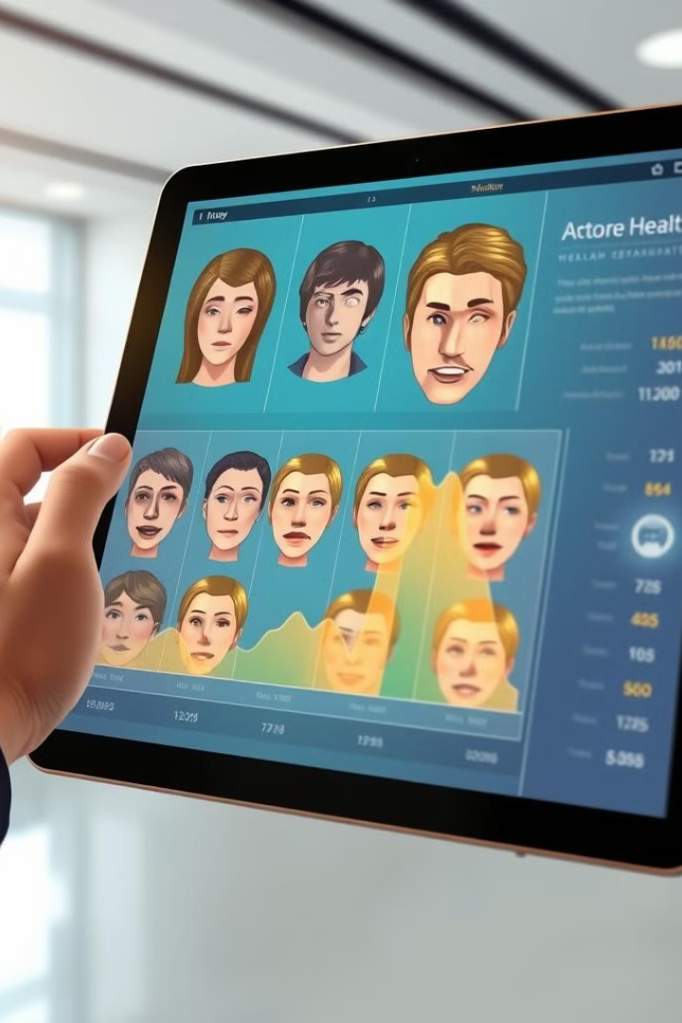
Mental Health Assessment: AI-Powered Facial Expression Analysis
Facial expression analysis is emerging as a valuable tool in mental health assessment, offering potential for early detection and monitoring of mood disorders. By leveraging AI and ML, this technology aims to augment traditional methods and enhance the accuracy of diagnosis and treatment.
Notes:
1

Slide 2

Introduction: The importance of early mental health detection
1
Early Intervention
2
Proactive Monitoring
Early detection of mental health conditions is crucial for effective intervention and improved outcomes.
AI-powered facial expression analysis allows for continuous monitoring of emotional states, enabling proactive interventions.
3
Personalized Care
4
Improved Outcomes
This technology can tailor treatment plans and support services to meet individual needs.
Early detection and personalized care can lead to better management of mental health conditions and improved overall well-being.
Notes:
2

Slide 3



How facial expressions reflect emotional states
Happiness
Sadness
Anger
Smiling, raised eyebrows, and crinkled eyes.
Frowning, downturned mouth, and furrowed brows.
Furrowed brows, narrowed eyes, and tightened jaw.
Notes:
3

Slide 4
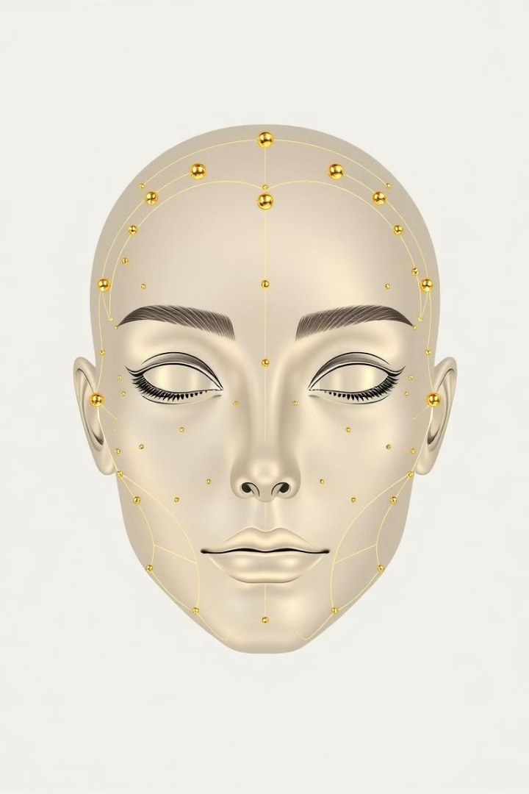
The science behind facial expression recognition
Facial Feature Detection
1
AI algorithms analyze facial features, including eyebrows, eyes, mouth, and nose.
Expression Recognition
2
The system identifies patterns in facial movements associated with specific emotions.
Emotional Interpretation
3
AI interprets the recognized expressions to assess the individual's emotional state.
Notes:
4

Slide 5
Leveraging AI and ML for mental health assessment
Machine Learning Algorithms
Data Analysis
Predictive Modeling
AI analyzes facial expressions in real-time, identifying subtle cues and changes over time.
AI can predict the likelihood of developing mental health conditions based on facial expressions.
Deep learning models are trained on large datasets of facial expressions and corresponding emotional states.
Notes:
5

Slide 6




Overcoming the limitations of traditional approaches
Subjectivity
Traditional methods rely on subjective self-reporting, which can be influenced by social desirability bias.
Objective Assessment
Facial expression analysis provides objective and quantifiable data, reducing the impact of subjectivity.
Early Detection
AI-powered analysis allows for early detection of subtle changes in emotional state, potentially leading to earlier intervention.
Notes:
6

Slide 7
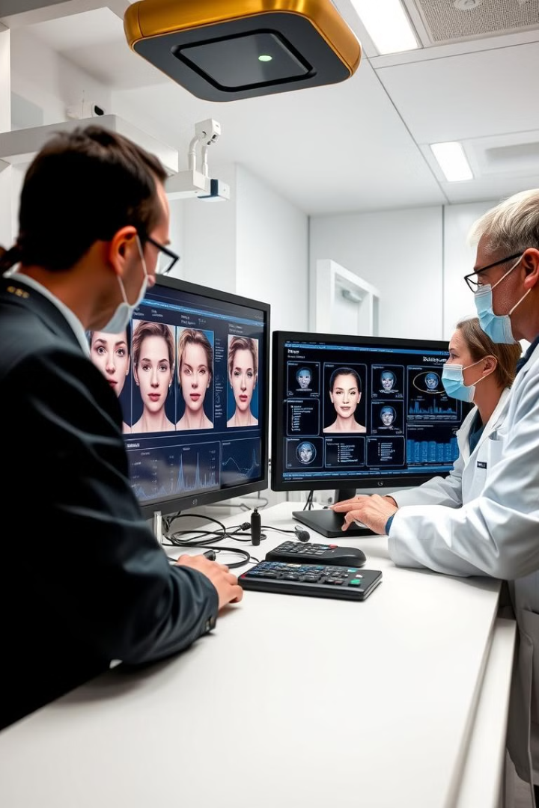
Case studies: Successful deployments of the technology
Study 1
Improved accuracy in diagnosing depression.
Study 2
Enhanced monitoring of anxiety levels in patients with PTSD.
Study 3
Effective identification of early signs of bipolar disorder.
Notes:
7

Slide 8




Integrating facial analysis into clinical workflows
Remote Monitoring
Patients can be monitored remotely using webcams or mobile devices.
Data Visualization
AI generates visual reports and graphs that illustrate emotional trends over time.
Personalized Feedback
AI can provide personalized feedback and recommendations to patients and healthcare providers.
Notes:
8

Slide 9

Addressing privacy and ethical concerns
Data Security
Informed Consent
Bias Mitigation
Ensuring secure storage and handling of sensitive patient data is paramount.
Patients must provide informed consent for the use of AI-powered facial expression analysis.
AI algorithms must be trained on diverse datasets to minimize bias and ensure fairness.
Notes:
9

Slide 10

Future advancements and research directions
1
Enhanced Accuracy
2
Personalized Treatment
Continued research aims to improve the accuracy and reliability of AI-powered facial expression analysis.
AI can be used to develop personalized treatment plans based on individual emotional responses.
3
Ethical Frameworks
Developing robust ethical frameworks for the responsible use of AI in mental health care is essential.
Notes:
10

